Slide 1
Grey Hats at UH Manoa
Fall 2016

Slide 2
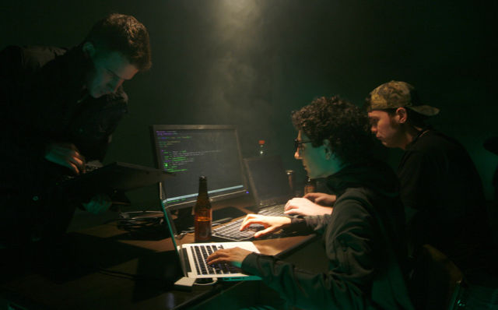
The Board
Redacted -President
Redacted -Vice President
Redacted -Vice President
Redacted -Secretary, facebook

Slide 3
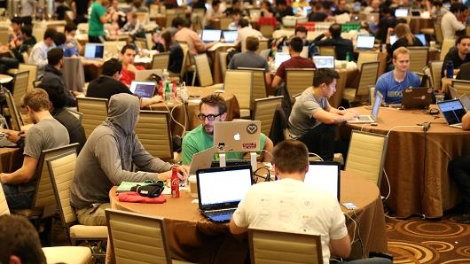
Fall Goals
-Compete in National Cyber League -Compete in monthly CTFs -Have bi-monthly tech talks -Build foundation for spring competitions; CCDC and Hawaiian Telcom CTF

Slide 4
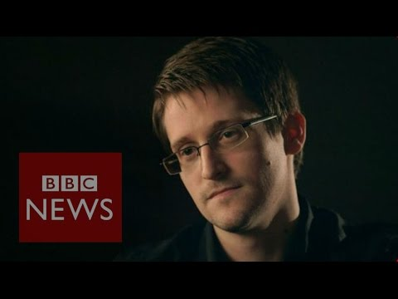
Challenge Solution
Hex-to-text
“Arguing that you don't care about the right to privacy because you have nothing to hide is no different than saying you don\'t care about free speech because you have nothing to say”
-Edward Snowden

Slide 5
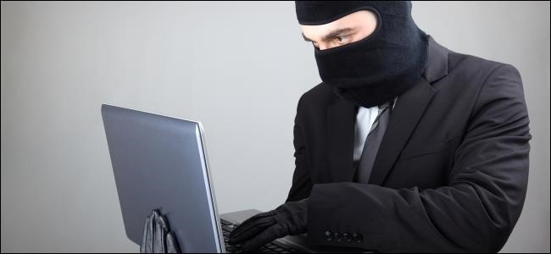
Important Dates
Tech Talk: Electromechanics and Semiconductors - 12SEP
CTF: CSAW CTF Quals - 16SEP
NCL Registration - Ends 23OCT
Getting Started: github.com/uhmgreyhats/getting-started

